Slide 1
Royal Musical Association: Music Educational Initiative City University, 15 November 2019
Prof. Barbara Kelly, President-Elect (RNCM)
Prof. Deborah Mawer, Council Member (RBC)

Slide 2
Perspective of the Conservatoire and RMA
Maintaining access to music: state provision under pressure/threat
Who picks up the pieces?
Roles of Hubs, conservatoires, orchestras, others
http://myhub.org.uk
https://gmmusichub.co.uk
https://www.liverpoolphil.com/about-us/music-education-for-all-ages/
https://www.cameratacommunity.co.uk
https://www.rncm.ac.uk/news/rncm-launches-pathfinder-initiative/

Slide 3
RMA Music Educational Initiative
Purpose
Part of strategy to increase diversity and inclusivity of the RMA
Aim to strengthen interface with schools and music teachers (initial focus upon sixth-form level)
Progress
Educational working group, with schools representation
Questionnaire to music-teacher members of RMA re priorities
Plans include one-day conference/workshop, late spring 2020

Slide 4
RMA/Broader priorities
1. Erosion of skills
Profound need to safeguard a range of musical/musicological skills
Lack of music skills/confidence amongst primary school teachers
Particular concern over music theory (SMA concern: ‘musical literacy’)
Perception of dumbing down of musical grammar
Crucially, inclusive, not in opposition to critical musicology, ethnomusicology etc.

Slide 5
RMA/Broader priorities (cont.)
2. Secondary qualifications
Sharp decline in A-level Music and GCSE uptake (EBacc problem)
Perception of difficulty for HE/scholarly associations to have access/influence with examination boards
Some teacher concern about new projected model curriculum (KS1-3).
3. Gaps or divides
Secondary/tertiary gap continues (RMA, MusicHE concern)
Insufficient university involvement; some school-based fear of HE. Need to breakdown misconceptions (breadth of HE beyond A-level exam syllabuses).
Persistence of broad North-South divide; Affluence/poverty gap
Improving opportunities

Slide 6
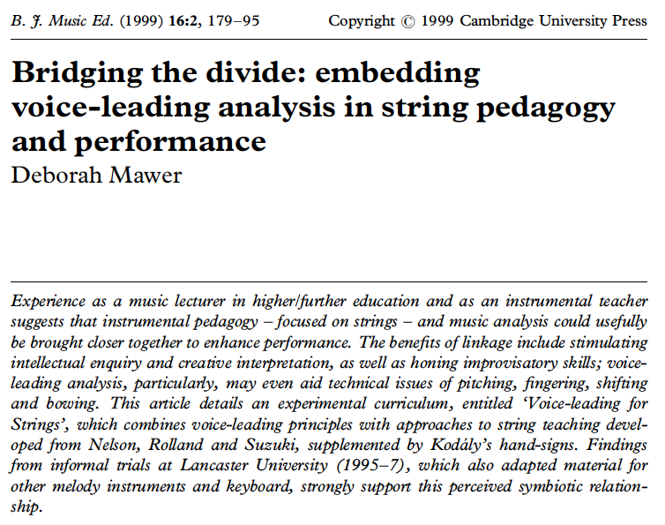
Priorities, opportunities (cont.)

